Slide 1
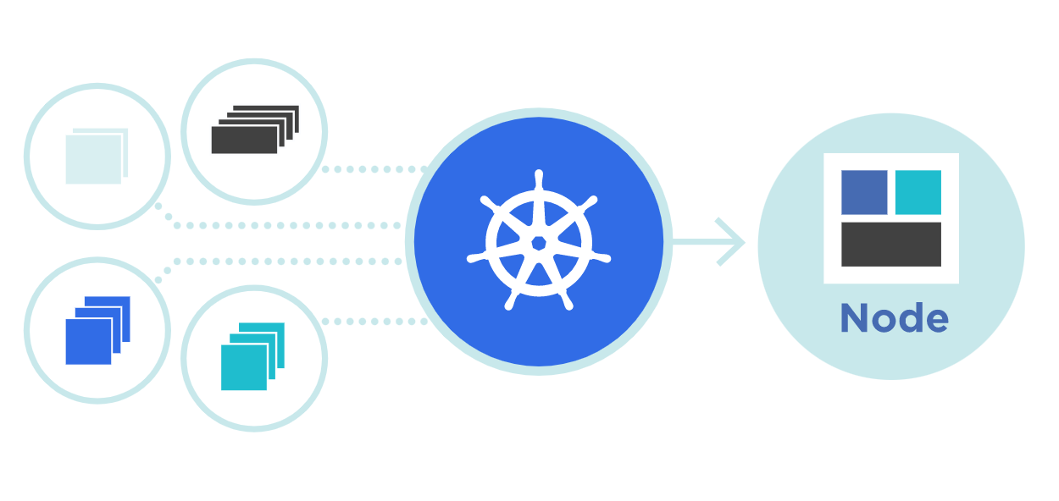



ReplicationController
rs
Theory + LAB + Documents ➔ All free
WATCH NOW
Notes:
Hello everyone. My name is Anish Rana and you are watching Kubernetes web series.
If you are new to this channel and wish to learn Kubernetes from the scratch, then you may click on the I button at top right-hand side for the Kubernetes playlist.
I added the Kubernetes playlist URL in the description.
Just for your information, this power point document can be downloaded from my Github page. Besides this, subtitle for different languages, such as English, French, Russian and German, are available for this video.
Today, we're going to cover one interesting topic, i.e. “What is ReplicationController?"

Slide 2
Agenda of this video.
What is ReplicationController?
Understand the fields in yaml file.
How to create Yaml file for ReplicationController?
How to create ReplicationController from Yaml file?
How to check the ReplicationController?
When to use a ReplicationController?
How to delete the ReplicationController?
LAB
rs

Slide 3
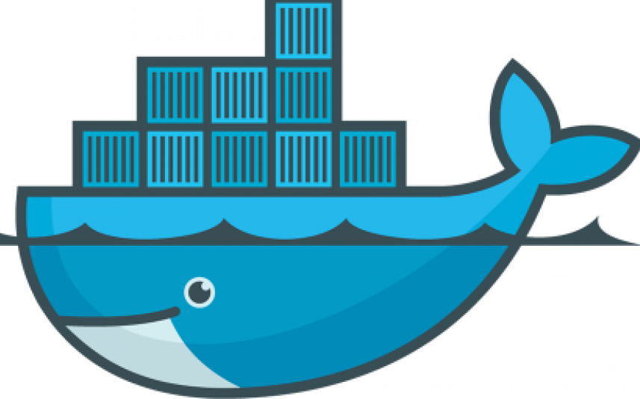

Why we use ReplicationController?
rs
kubectl create –f <pod yaml>
POD

Slide 4
Why we use ReplicationController?
rs
kubectl create –f <pod yaml>
kubectl create –f <pod yaml>
kubectl create –f <pod yaml>
POD
POD
POD
workernode 1

Slide 5

Why we use ReplicationController?
rs
POD
POD
POD
POD
POD
POD
workernode 1
workernode 2

Slide 6
01 NOW WE WILL TALK ABOUT
What is ReplicationController?

Slide 7
What is ReplicationController?
1. If any pod goes down then we must re-create the POD again.
2. For identical PODs, we have run again and again same command with different POD names.
3. Manually monitoring of these PODs.
4. Manually increase or decrease the numbers of PODs (scale up or scale down, respectively).
5. Reliability is missing, means auto-healing.
A ReplicationController ensures that a specified number of pod replicas are running at any one time.

Slide 8

What is ReplicationController?
rs
POD
POD
POD
POD
POD
POD
workernode 1
workernode 2

Slide 9

Worker node 1 / VM
Master node 1 / VM
Schedular
POD 1
C: webapp1
Kubelet
API Server
Etcd Database
Kube-Proxy
POD 2
C: database1
Controller
Kubernetes
Kubernetes
Docker Engine
Docker Engine
CentOS 9
CentOS 9

Slide 10
02 NOW WE WILL TALK ABOUT
Understand the fields in Yaml

Slide 11
apiVersion: v1
kind: ReplicationController
metadata:
name: nginx
spec:
kubectl apply -f https://k8s.io/examples/controllers/replication.yaml

Slide 12
apiVersion: v1
kind: ReplicationController
metadata:
name: nginx
spec:
replicas: 3
selector:
app: nginx
template:
metadata:
name: nginx
labels:
app: nginx
spec:
containers:
- name: nginx
image: nginx
ports:
- containerPort: 80
contain no more than 253 characters
contain only lowercase alphanumeric characters, '-' or '.'
start with an alphanumeric character
end with an alphanumeric character

Slide 13
apiVersion: v1
kind: ReplicationController
metadata:
name: nginx
spec:
replicas: 3
selector:
app: nginx
template:
metadata:
name: nginx
labels:
app: nginx
spec:
containers:
- name: nginx
image: nginx
ports:
- containerPort: 80
ReplicationController will select the pods with this label
ReplicationController will create the pods with this label

Slide 14
apiVersion: v1
kind: ReplicationController
metadata:
name: nginx
spec:
replicas: 3
selector:
app: nginx
template:
metadata:
name: nginx
labels:
app: nginx
spec:
containers:
- name: nginx
image: nginx
ports:
- containerPort: 80
Both values must be equal then only these pods will be selected by ReplicationController

Slide 15
apiVersion: v1
kind: ReplicationController
metadata:
name: nginx
labels:
app: nginx
spec:
replicas: 3
selector:
app: nginx
template:
metadata:
name: nginx
labels:
app: nginx
spec:
containers:
- name: nginx
image: nginx
ports:
- containerPort: 80
(.metadata.labels)

Slide 16
apiVersion: v1
kind: ReplicationController
metadata:
name: nginx
labels:
app: nginx
spec:
replicas: 3
selector:
app: nginx
template:
metadata:
name: nginx
labels:
app: nginx
spec:
containers:
- name: nginx
image: nginx
ports:
- containerPort: 80
(.metadata.labels)
(.spec.selector)
Both values must be equal then only these pods will be selected by ReplicationController
(.spec.template.metadata.labels )

Slide 17
apiVersion: v1
kind: ReplicationController
metadata:
name: nginx
labels:
app: nginx
spec:
replicas: 3
selector:
app: nginx
template:
metadata:
name: nginx
labels:
app: nginx
spec:
containers:
- name: nginx
image: nginx
ports:
- containerPort: 80
(.metadata.labels)
(.spec.selector)
Both values must be equal then only these pods will be selected by ReplicationController
(.spec.template.metadata.labels )

Slide 18
apiVersion: v1
kind: ReplicationController
metadata:
name: nginx
labels:
app: nginx
spec:
replicas: 3
selector:
app: nginx
template:
metadata:
name: nginx
labels:
app: nginx
spec:
containers:
- name: nginx
image: nginx
ports:
- containerPort: 80
Its own labels
ReplicationController will select the pods with this label
Both values must be equal then only these pods will be selected by ReplicationController
ReplicationController will create the pods with this label

Slide 19
03 NOW WE WILL TALK ABOUT
How to create Yaml file for ReplicationController?

Slide 20
apiVersion: v1
kind: ReplicationController
metadata:
name: frontend
labels:
tier: frontend
spec:
replicas: 3
selector:
tier: frontend
template:
metadata:
apiVersion: v1
kind: Pod
metadata:
name: nginx
metadata:
name: nginx
labels:
tier: frontend
spec:
containers:
- name: nginx
image: nginx:1.14.1
ports:
- containerPort: 80

Slide 21
apiVersion: v1
kind: ReplicationController
metadata:
name: frontend
labels:
tier: frontend
spec:
replicas: 3
selector:
tier: frontend
template:
metadata:
name: nginx
labels:
tier: frontend
spec:
containers:
- name: nginx
image: nginx:1.14.1
ports:
- containerPort: 80
apiVersion: v1
kind: Pod
metadata:
name: nginx

Slide 22
apiVersion: v1
kind: ReplicationController
metadata:
name: frontend
labels:
tier: frontend
spec:
replicas: 3
selector:
tier: frontend
template:
metadata:
name: nginx
labels:
tier: frontend
spec:
containers:
- name: nginx
image: nginx:1.14.1
ports:
- containerPort: 80
ReplicationController
POD
Container

Slide 23
04 NOW WE WILL TALK ABOUT
Create ReplicationController from Yaml file?

Slide 24
[root@master1 ~]# kubectl apply -f https://k8s.io/examples/controllers/replication.yaml
replicaset.apps/frontend created
[root@master1 data]# kubectl get replicationcontrollers
NAME DESIRED CURRENT READY AGE
Nginx 3 3 3 9m17s
[root@master1 ~]# kubectl get rc
NAME DESIRED CURRENT READY AGE
Nginx 3 3 3 2m19s
[root@master1 ~]# kubectl get pods
NAME READY STATUS RESTARTS AGE
pod/nginx-99bbt 1/1 Running 0 39s
pod/nginx-hfrvf 1/1 Running 0 39s
pod/nginx-nbzzz 1/1 Running 0 39s

Slide 25
05 NOW WE WILL TALK ABOUT
How to check ReplicationController / rc ?

Slide 26
[root@master1 ~]# kubectl describe rc/nginx
Name: nginx
Namespace: default
Selector: app=nginx
Labels: app=nginx
Annotations: <none>
Replicas: 3 current / 3 desired
Pods Status: 3 Running / 0 Waiting / 0 Succeeded / 0 Failed
Pod Template:
Labels: app=nginx
Containers:
nginx:
Image: nginx
Port: 80/TCP
Host Port: 0/TCP
Environment: <none>
Mounts: <none>
Volumes: <none>
Events:
Type Reason Age From Message
---- ------ ---- ---- -------
Normal SuccessfulCreate 6m42s replication-controller Created pod: nginx-hfrvf
Normal SuccessfulCreate 6m42s replication-controller Created pod: nginx-99bbt
Normal SuccessfulCreate 6m42s replication-controller Created pod: nginx-nbzzz
[root@master1 ~]#

Slide 27
06 NOW WE WILL TALK ABOUT
What happen if one pod goes down?

Slide 28
[root@master1 ~]# kubectl get pods
NAME READY STATUS RESTARTS AGE
pod/nginx-99bbt 1/1 Running 0 39s
pod/nginx-hfrvf 1/1 Running 0 39s
pod/nginx-nbzzz 1/1 Running 0 39s
[root@master1 ~]# kubectl delete pod/nginx-nbzzz
pod "nginx-nbzzz" deleted
[root@master1 ~]# kubectl get pods
NAME READY STATUS RESTARTS AGE
nginx-99bbt 1/1 Running 0 61s
nginx-hfrvf 1/1 Running 0 61s
nginx-rtw4d 1/1 Running 0 6s

Slide 29
06 NOW WE WILL TALK ABOUT
How to upgrade the replicationcontroller / rc ?

Slide 30
Update from YAML file.
From command line.
Upgrade the NGINX from 1.14.1 to 1.14.2
kubectl set image replicationcontroller frontend nginx=nginx:1.14.2
kubectl set image resource type (replicationcontroller) Name of RC(frontend) Containername(nginx )=New Image (nginx:1.14.2 )
We need to delete the existing pod manually and then recreate it.

Slide 31
07 NOW WE WILL TALK ABOUT
How to delete the ReplicationController / rc ?

Slide 32
[root@master1 ~]# kubectl delete replicationcontrollers nginx
replicationcontroller "nginx" deleted
[root@master1 data]# kubectl get rc
No resources found in default namespace.
[root@master1 ~]# kubectl get pods
No resources found in default namespace.

Slide 33
08 NOW WE WILL TALK ABOUT
When to use a ReplicationController / rc?

Slide 34
A ReplicationController ensures that a specified number of pod replicas are running at any given time.
We can upgrade the PODs.
The ReplicationController is forever constrained to this narrow responsibility.
It itself will not perform readiness nor liveness probes.
The Replication Controller is the original form of replication in Kubernetes.
Nowadays, no one is using ReplicationController.
Replica Controller is deprecated and replaced by ReplicaSets.

